Slide 1


Slide 2
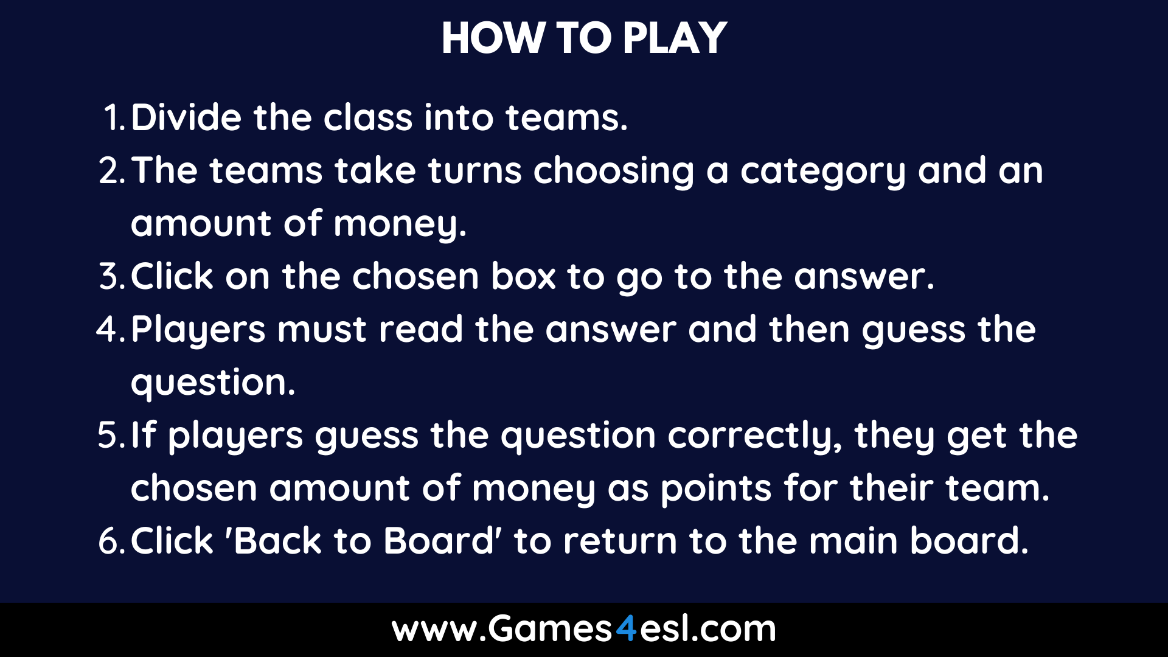

Slide 3

Category 1
Category 2
Category 3
Category 4
Category 5
Category 6
$200
$200
$200
$200
$200
$200
$400
$400
$400
$400
$400
$400
$600
$600
$600
$600
$600
$600
$800
$800
$800
$800
$800
$800
$1000
$1000
$1000
$1000
$1000
$1000

Slide 4

Category 1: $200
TYPE YOUR QUESTION HERE
Type your answer here and students should guess the question.
Back To Board

Slide 5
Category 1: $400
TYPE YOUR QUESTION HERE
Type your answer here and students should guess the question.
Back To Board

Slide 6
Category 1: $600
TYPE YOUR QUESTION HERE
Type your answer here and students should guess the question.
Back To Board

Slide 7
Category 1: $800
TYPE YOUR QUESTION HERE
Type your answer here and students should guess the question.
Back To Board

Slide 8
Category 1: $1000
TYPE YOUR QUESTION HERE
Type your answer here and students should guess the question.
Back To Board

Slide 9
Category 2: $200
TYPE YOUR QUESTION HERE
Type your answer here and students should guess the question.
Back To Board

Slide 10
Category 2: $400
TYPE YOUR QUESTION HERE
Type your answer here and students should guess the question.
Back To Board

Slide 11
Category 2: $600
TYPE YOUR QUESTION HERE
Type your answer here and students should guess the question.
Back To Board

Slide 12
Category 2: $800
TYPE YOUR QUESTION HERE
Type your answer here and students should guess the question.
Back To Board

Slide 13
Category 2: $1000
TYPE YOUR QUESTION HERE
Type your answer here and students should guess the question.
Back To Board

Slide 14
Category 3: $200
TYPE YOUR QUESTION HERE
Type your answer here and students should guess the question.
Back To Board

Slide 15
Category 3: $400
TYPE YOUR QUESTION HERE
Type your answer here and students should guess the question.
Back To Board

Slide 16
Category 3: $600
TYPE YOUR QUESTION HERE
Type your answer here and students should guess the question.
Back To Board

Slide 17
Category 3: $800
TYPE YOUR QUESTION HERE
Type your answer here and students should guess the question.
Back To Board

Slide 18
Category 3: $1000
TYPE YOUR QUESTION HERE
Type your answer here and students should guess the question.
Back To Board

Slide 19
Category 4: $200
TYPE YOUR QUESTION HERE
Type your answer here and students should guess the question.
Back To Board

Slide 20
Category 4: $400
TYPE YOUR QUESTION HERE
Type your answer here and students should guess the question.
Back To Board

Slide 21
Category 4: $600
TYPE YOUR QUESTION HERE
Type your answer here and students should guess the question.
Back To Board

Slide 22
Category 4: $800
TYPE YOUR QUESTION HERE
Type your answer here and students should guess the question.
Back To Board

Slide 23
Category 4: $1000
TYPE YOUR QUESTION HERE
Type your answer here and students should guess the question.
Back To Board

Slide 24
Category 5: $200
TYPE YOUR QUESTION HERE
Type your answer here and students should guess the question.
Back To Board

Slide 25
Category 5: $400
TYPE YOUR QUESTION HERE
Type your answer here and students should guess the question.
Back To Board

Slide 26
Category 5: $600
TYPE YOUR QUESTION HERE
Type your answer here and students should guess the question.
Back To Board

Slide 27
Category 5: $800
TYPE YOUR QUESTION HERE
Type your answer here and students should guess the question.
Back To Board

Slide 28
Category 5: $1000
TYPE YOUR QUESTION HERE
Type your answer here and students should guess the question.
Back To Board

Slide 29
Category 6: $200
TYPE YOUR QUESTION HERE
Type your answer here and students should guess the question.
Back To Board

Slide 30
Category 6: $400
TYPE YOUR QUESTION HERE
Type your answer here and students should guess the question.
Back To Board

Slide 31
Category 6: $600
TYPE YOUR QUESTION HERE
Type your answer here and students should guess the question.
Back To Board

Slide 32
Category 6: $800
TYPE YOUR QUESTION HERE
Type your answer here and students should guess the question.
Back To Board

Slide 33
Category 6: $1000
TYPE YOUR QUESTION HERE
Type your answer here and students should guess the question.
Back To Board

